Slide 1
Weekly report: Electrical Drivetrain
Week number: 8
Date: 11/18/2025
Supervisor: Prof. Dr.-Ing. Saiju
Group members: Aiswarya Vijayan, Vishranti Shivajirao Patil , Girish Mahadeo Padalkar, Cristina Milene Vergara Hernandez

Slide 2
List of contents
Implement MATLAB model of the DFIG
Generate characteristic curves (T–N, I–N, P–N)
Validate generator behavior across speed range
Begin building the Simscape model for all drivetrain components
Results for Converter Parameters
Cristina Vergara
Electrical Drive Train/ Optimus Syria

Slide 3
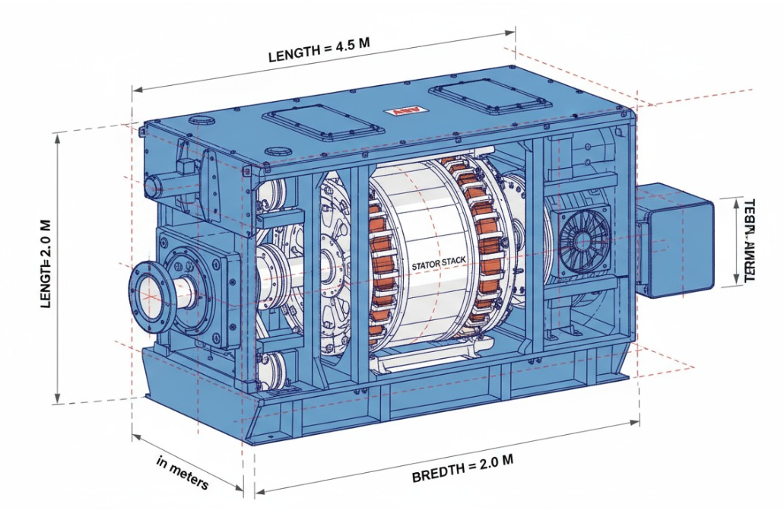
Generator and Parameters
Parameter | Symbol | Value | Unit
Rated Active Power | Pn | 5.31e6 | W
Line Voltage (LL) | Vn | 960 | V
Frequency | f | 50 | Hz
Number of Poles | p | 6 | –
Pole Pairs | pp | 3 | –
Stator Resistance | Rs | 0.0818 | Ω
Rotor Resistance | Rr | 0.253 | Ω
Stator Leakage Inductance | Lls | 0.001474 | H
Rotor Leakage Inductance | Llr | 0.001474 | H
Magnetizing Inductance | Lm | 0.01295 | H
Rotor/Stator Volt. Ratio | Vr/Vs | 0.2 | –
Synchronous Speed | Ns | 1000 | rpm
Rated Rotor Speed | Nr | 1200 | rpm
Slip (supersync.) | s | –0.2 | –
Rotor Inertia | J | 4647 | kg·m²
Cristina Vergara
Electrical Drive Train/ Optimus Syria

Slide 4
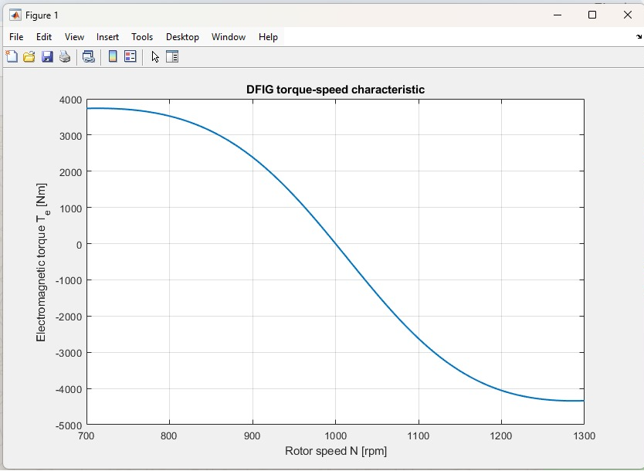
Torque-Speed Characteristic
Torque is positive below synchronous speed
Zero torque ~1000 rpm
Negative torque above synchronous speed → generator region
Curve shape matches theoretical DFIG characteristics
Cristina Vergara

Slide 5
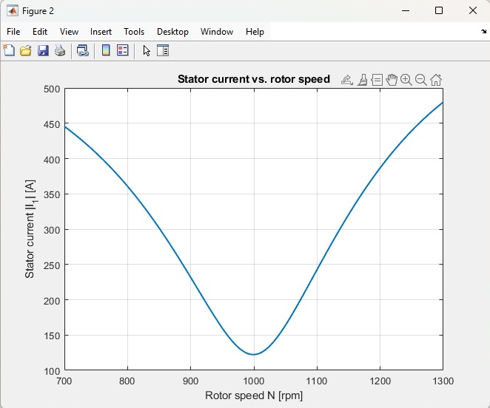
Stator Current vs Rotor Speed
Stator current is lowest near synchronous speed
Higher slip → higher stator current
Symmetrical behaviour indicates correct model implementation
Cristina Vergara

Slide 6
Mechanical Power vs Rotor Speed
Mechanical power peaks at low speed (motor side)
Zero crossing at synchronous speed
Becomes negative in generator range (expected)
Confirms correct energy flow direction
Cristina Vergara

Slide 7
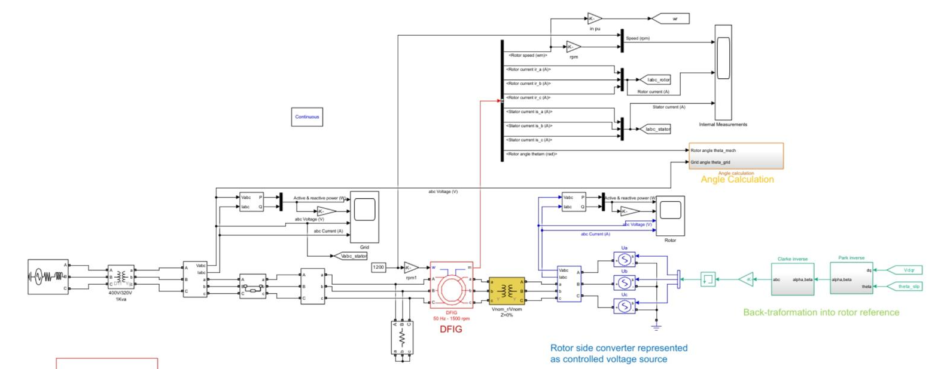
Progress on Simscape Drivetrain Model
DFIG block selected and configured
Parameters identified (R, L, Lm, poles, rated values)
Values transferred from design table into the model
Model runs with custom generator parameters
Cristina Vergara

Slide 8
Converter Parameters (Updated)
Parameter | Unit | Value | Notes
Power Range | MW | 1.25 | 25% of 5MW DFIG
Nominal Voltage (VLL​) | V | 960 | User-specified AC voltage.
DC-Link Voltage (Vdc​) | V | 1536 | 1.6×VLL​ (Calculated).
Switching Frequency (fsw​) | kHz | 2.5 | Typical value for high-power IGBT converters (2−4 kHz).
DC Link Capacitance (Cdc​) | mF | 75 | Estimated for ∼7 ms holdup time and 5% voltage ripple.
Rectifier Side Inductance (Lr​) | mH | 0.18 | External coupling inductor for Rotor Side Converter (≈7.5% pu).
Inverter Side Inductance (L1​) | mH | 0.12 | Converter side inductor of the Grid LCL filter.
Filter Capacitor (Cf​) | μF | 125 | Estimated for 5% reactive power absorption at VLL​.
Grid Side Inductance (L2​) | mH | 0.06 | Grid side inductor of the Grid LCL filter.
Filter Resistance (Rd​) | Ω | 1−3 | Estimate for passive damping of the LCL filter resonance.
Dimensions (L×W×H) | mm | 2000×1000×2200 | Typical dimensions for a 1.25 MW liquid-cooled cabinet.
Weight | kg | 1500−3500 | Typical weight range for a 1.25 MW VSC cabinet.
Auxiliary Supply | V | 400 VAC​ | Standard 3-phase supply for cooling/auxiliary motors and pumps.
Cristina Vergara

Slide 9
6.Next Step
Complete the Simscape drivetrain diagram and add all parameters.
Run the first full simulation and compare it with the MATLAB results.
3D modeling (Fusion 360) of components
Cristina Vergara

Slide 10

Bibliography
MathWorks. Simscape Electrical Documentation.
https://www.mathworks.com/help/sps/
Access Date – 06/11/2025
MathWorks. Asynchronous Machine (Wound Rotor) – Simscape Electrical.
https://www.mathworks.com/help/sps/ref/asynchronousmachine.html
Access Date – 06/11/2025
MathWorks. DFIG Wind Turbine Examples (Simscape).
https://www.mathworks.com/help/sps/ug/wind-turbine-modeling.html
Access Date – 06/11/2025
MathWorks. Wind Turbine Induction Generator Models.
https://www.mathworks.com/help/sps/powersys/ref/dfigwindturbine.html
Access Date – 06/11/2025
11/18/2025
Cristina Vergara
9

